Slide 1
Instacart Grocery Basket
Objective
To perform an initial data and exploratory analysis of some of their data in order to derive insights and suggest strategies for better segmentation based on the provided criteria. Project brief can be found here.
Data Set
Open-source data set was provided by Instacart.
Customer data set can be found here.
Tools and Procedures
Python
Data wrangling
Data merging
Deriving variables
Grouping data
Aggregating data
Reporting in Excel
Population flows

Slide 2
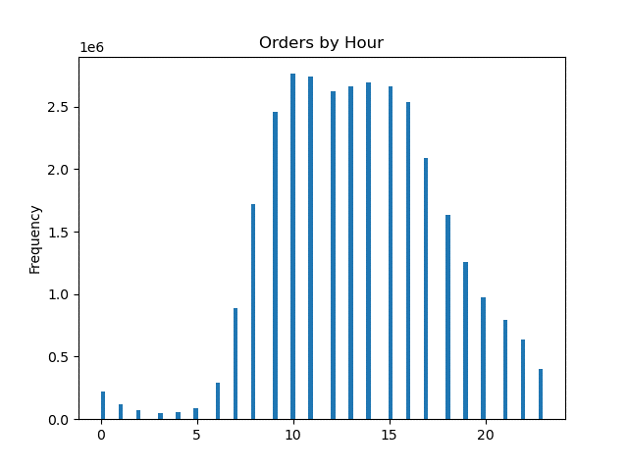
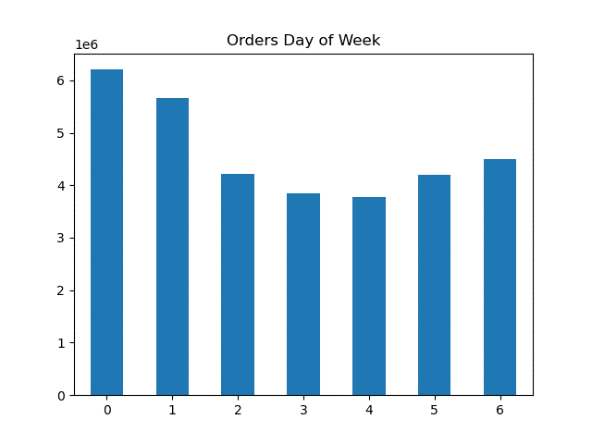
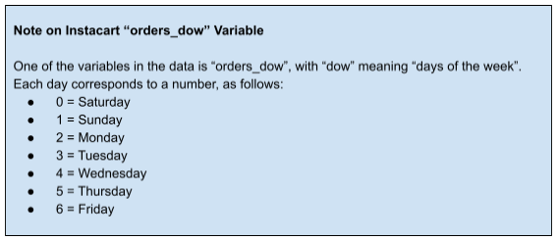
ANALYSIS and Recommendations
The sales team needs to know what the busiest days of the week and hours of the day are (i.e., the days and times with the most orders) in order to schedule ads at times when there are fewer orders.
The busiest days of the week are Saturday and Sunday.
The busiest hours of the day are from 9:00 a.m. to 5:00 p.m.
It is recommended to schedule ads on Tuesday and Wednesday from 9:00 a.m. to 5:00 p.m. to increase orders on these particular days.

Slide 3
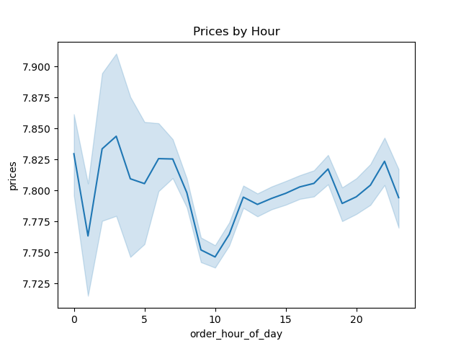
ANALYSIS and Recommendations
They also want to know whether there are particular times of the day when people spend the most money, as this might inform the type of products they advertise at these times.
Customer spend the most money from 10:00 a.m. to 4:00 p.m. The prices rises at 10:00 a.m. from 7.750 to 7.800 and remains consistent.
It is recommended to commence advertisement around these hours to increase customer spending.

Slide 4
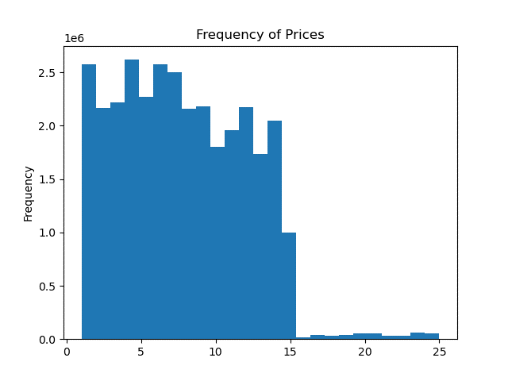
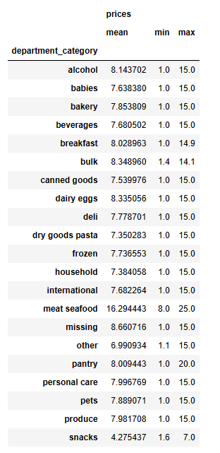
ANALYSIS and Recommendations
Instacart has a lot of products with different price tags. Marketing and sales want to use simpler price range groupings to help direct their efforts.
Most products are between $1 and $15, while a few are higher priced at $15 to $25.
It is recommended to market the lower priced products for customer awareness.

Slide 5
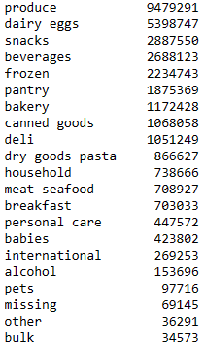
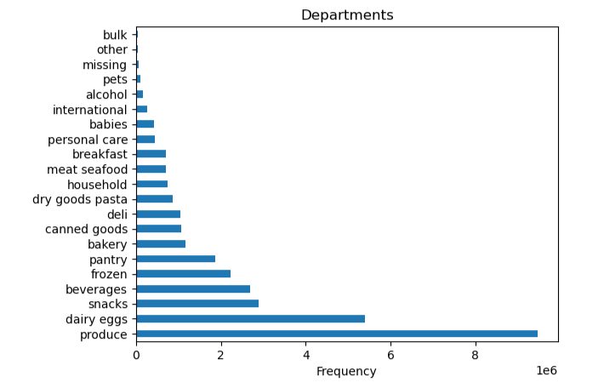
ANALYSIS and Recommendations
Are there certain types of products that are more popular than others? The marketing and sales teams want to know which departments have the highest frequency of product orders.
The produce department has the highest frequency with 9,479,291. Dairy eggs is more popular than beverages and snacks.
It is recommended to continue to market the most popular items while advertise the least popular items to increase purchases.

Slide 6

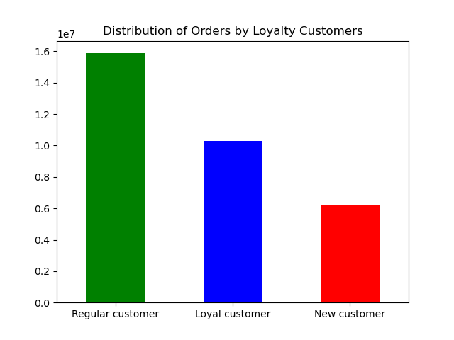
ANALYSIS and Recommendations
What’s the distribution among users in regards to their brand loyalty (i.e., how often do they return to Instacart)?
A regular customer orders over 10 but less than or equal to 40. A loyal customer orders more than 40. A new customer will order less than or equal to 10. The regular customer has the highest frequency among other users.
It is recommended that Instacart rewards the regular customers with discounts and additional perks.

Slide 7
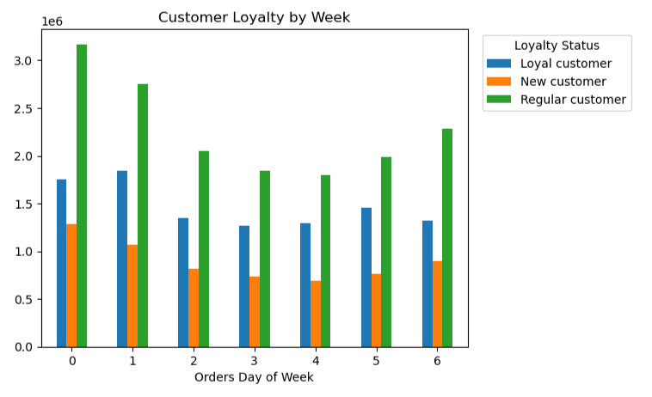
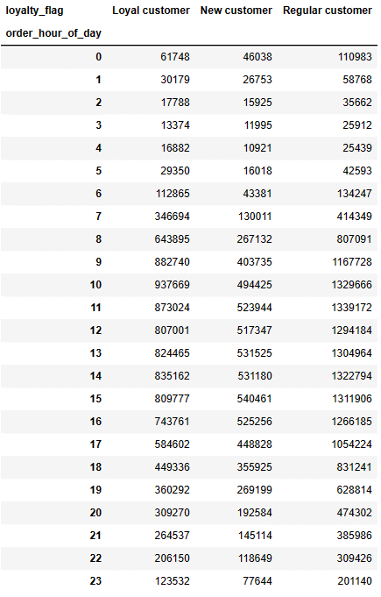
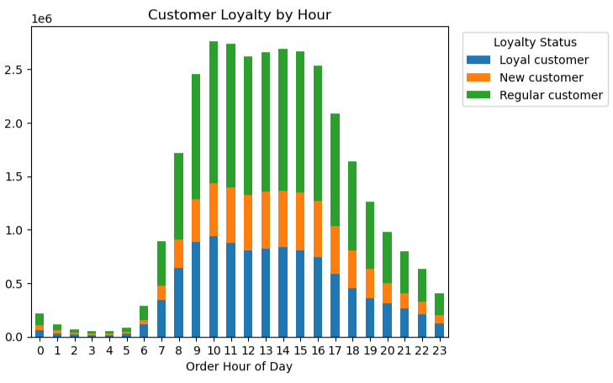
ANALYSIS and Recommendations
Are there differences in ordering habits based on a customer’s loyalty status?
Regular and new customers ordering habits are high on Saturdays. Loyalty customers ordering habits are high on Sundays. The ordering habits by hour are from 9:00 a.m. to 4:00 p.m.
It is recommended to reward the customers with discounts and additional perks.

Slide 8
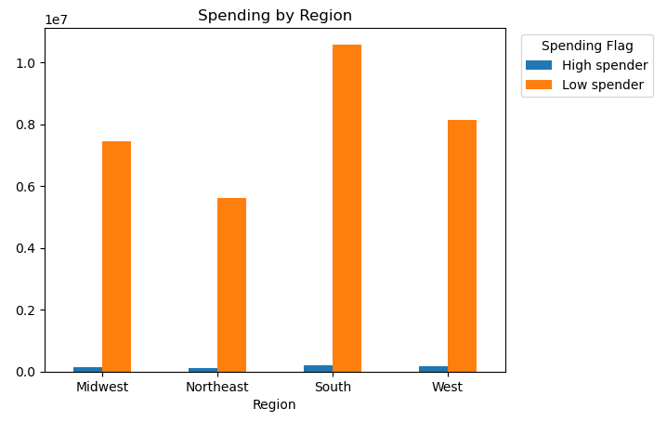
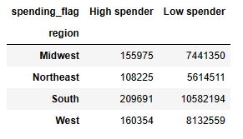


ANALYSIS AND RECOMMENDATIONS
Are there differences in ordering habits based on a customer’s region?
The South region has the lowest spenders. There are no differences in ordering habits.
It is recommended to promote ads in the Northeast to increase ordering habits.

